Slide 1


SUPERSTORE DATA USING SNOWFLAKE
1.Tejaswini 2.Sunil 3.Abhinav 4. Vikas 5. Meghna
Mentor by:- Pritam

Slide 2



WHAT IS SNOWFLAKE?
Snowflake is a cloud computing-based data warehousing solution.
Founded in 2012, Snowflake offers storage and analytics services.
It runs on Amazon S3, Microsoft Azure, and the Google Cloud platform.

Slide 3


INTRODUCTION
AIM : Implementing the snowflake methodologies for the given data extraction from AWS s3 Bucket.
SYSTEM REQUIRED : Window OS, Snowflake, AWS, Kaggle.
PLATFORM’s USED : Colab, Snowflake, AWS, GIT-HUB.
LANGUAGES USED : PYTHON, SQL

Slide 4


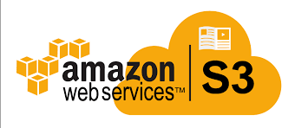

WORK FLOW
GIT-HUB

Slide 5

SUPERSTORE DATA SET
The dataset that we are using has the data of the orders such as order-id, ordered and shipping dates, product details, discount provided and the profits attained in different cities of United States.
Here, the data named superstore is being downloaded from the Kaggle site. (https://www.kaggle.com/datasets/vivek468/superstore-dataset-final )

Slide 6
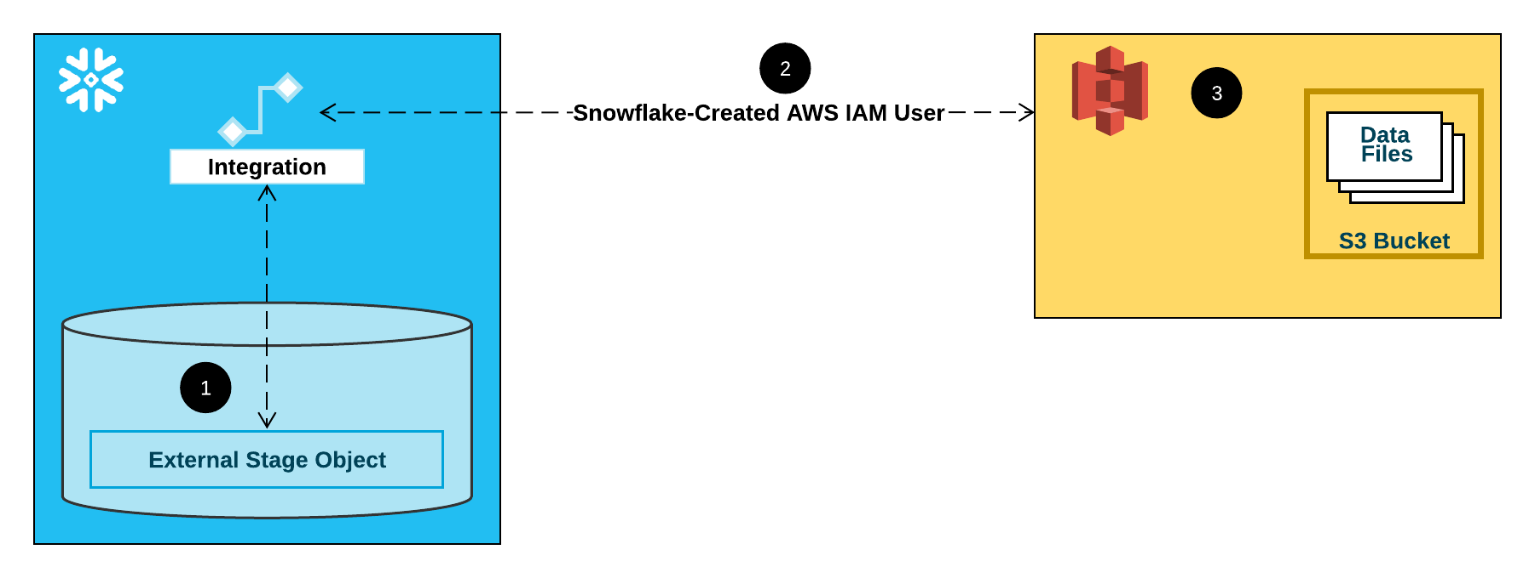
AWS TO SNOWFLAKE
Splitting the data into chunks for decreasing the complexity.
In order to copy the data from the external stage i.e., AWS s3 Bucket , we are creating a discrete integration on the s3 bucket and by creating the stage and a table for copying the superstore data by giving the format of the file.
The dataset is being copied into our snowflake table.

Slide 7

SCHEDHULING TASK
The crontab is used to set the particular time, date, month, day of the week etc., to load the data into the particular table at the given time.
So for scheduling the data loading we need to create a task for performing and copying the data.

Slide 8

SLOW CHANGING DIMENSION
SCD captures the data changes done in the particular table on which stream is being created.
Stream is a watcher or tracker which tracks the changed data in table.
In order to capture data changes we need two tables namely source table and consumer table.
Here we are using SCD2 which has the capability of storing each and every change in table i.e., contains complete history.

Slide 9
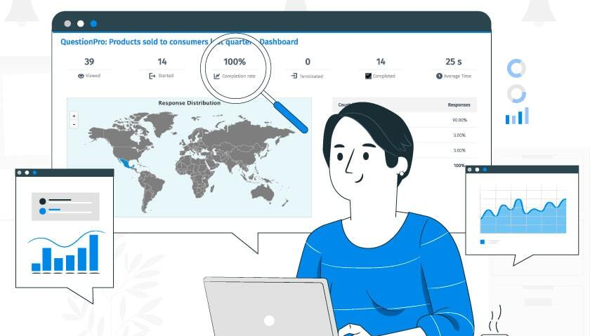
ANALYSIS ON THE DATASET
The following analysis are performed on our superstore dataset.
Calculate the number of Orders those with Ship Mode a ‘Second Class’?
List down the most valuable customers Country wise?
Total Sales for Category ‘Furniture’?
Which Product provides the maximum profit?
Calculate the total profit made by each product category country wise?
Which region of United States have majority loss?

Slide 10

ROW LEVEL SECURITY
Selection of particular rows, based on a unique id or name is known as ‘Row Level Security’.
Since, on the superstore we are going to perform row level security based on the region of the states in US.
The manager or head of that particular region can only have the access to data of that specific region.

Slide 11

GIT-HUB
GitHub is an increasingly popular programming resource used for code sharing. It's a social networking site for programmers that many companies and organizations use to facilitate project management and collaboration.
As the final step of the project the code of the project is shared in GitHub repository as a snowflake_code.txt file which has the visibility to everyone.
(https://github.com/sunilmann/snowflake_p1)

Slide 12

Thank You
THANK YOU

